Slide 1
Transistor
Sikandar Khan

Slide 2
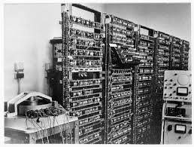

Slide 3
Lecture Overview
What is a transistor?
  Uses
  History
  Background Science
Transistor Properties
Types of transistors
  Bipolar Junction Transistors
  Field Effect Transistors
  Power Transistors

Slide 4
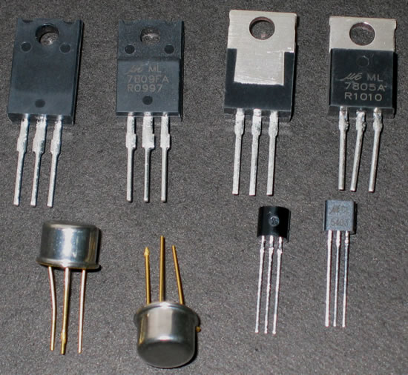
What is a transistor?
A transistor is a 3 terminal electronic device made of semiconductor material.
Transistors have many uses, including amplification, switching, voltage regulation, and the modulation of signals

Slide 5
History
Before transistors were invented, circuits used vacuum tubes:
  Fragile, large in size, heavy, generate large quantities of heat, require a large amount of power
The first transistors were created at Bell Telephone Laboratories in 1947
  William Shockley, John Bardeen, and Walter Brattain created the transistors in and effort to develop a technology that would overcome the problems of tubes.
  Shockley, Bardeen, and Brattain had referenced this material in their work

Slide 6
History
The word “transistor” is a combination of the terms “transconductance” and “variable resistor”
Today an advanced microprossesor can have as many as 1.7 billion transistors.

Slide 7
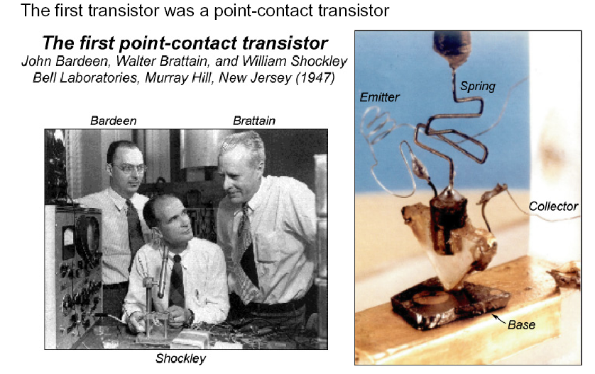
Point-Contact Transistor –
first transistor ever made

Slide 8
Background Science
Conductors
  Ex: Metals
  Flow of electricity governed by motion of free electrons
  As temperature increases, conductivity decreases due to more lattice atom collisions of electrons
  Idea of superconductivity
Insulators
  Ex: Plastics
  Flow of electricity governed by motion of ions that break free
  As temperature increases, conductivity increases due to lattice vibrations breaking free ions.

Slide 9
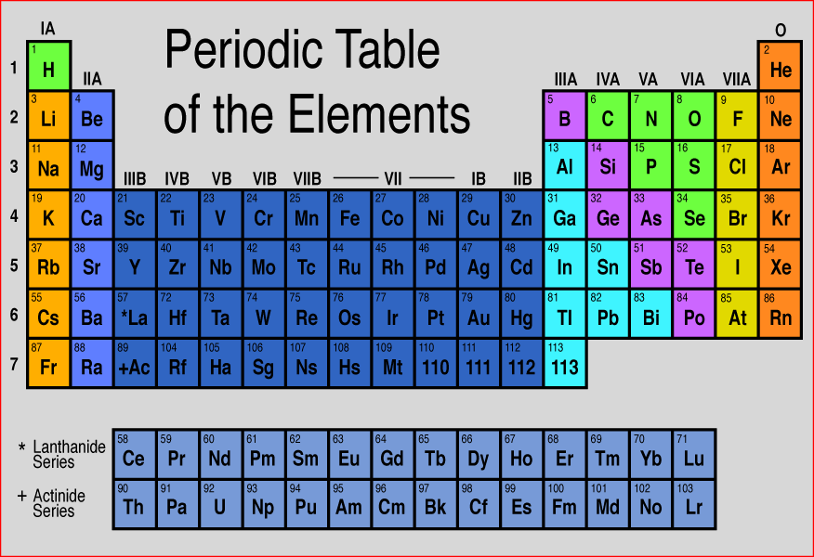
Semiconductors
Semiconductors are more like insulators in their pure form but have smaller atomic band gaps
Adding dopants allows them to gain conductive properties

Slide 10
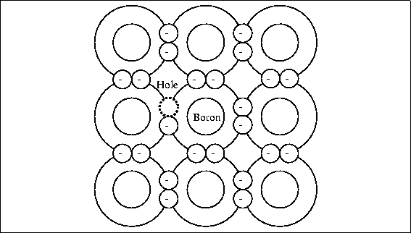
Doping
Foreign elements are added to the semiconductor to make it electropositive or electronegative
P-type semiconductor (postive type)
  Dopants include Boron, Aluminum, Gallium, Indium, and Thallium
  Ex: Silicon doped with Boron
  The boron atom will be involved in covalent bonds with three of the four neighboring Si atoms. The fourth bond will be missing and electron, giving the atom a “hole” that can accept an electron

Slide 11
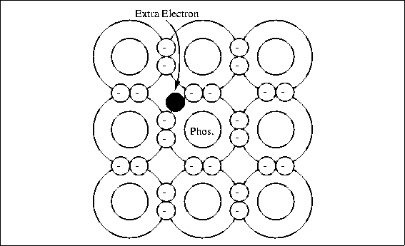
Doping
N-type semiconductor (negative type)
  Dopants include Nitrogen, Phosphorous, Arsenic, Antimony, and Bismuth
Ex: Silicon doped with Phosphorous
  The Phosphorous atom will contribute and additional electron to the Silicon giving it an excess negative charge

Slide 12
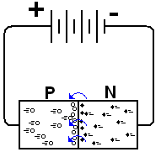
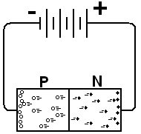
P-N Junction Diodes
Forward Bias
  Current flows from P to N
Reverse Bias
  No Current flows
  Excessive heat can cause dopants in a semiconductor device to migrate in either direction over time, degrading diode
  Ex: Dead battery in car from rectifier short
  Ex: Recombination of holes and electrons cause rectifier open circuit and prevents car alternator form charging battery

Slide 13
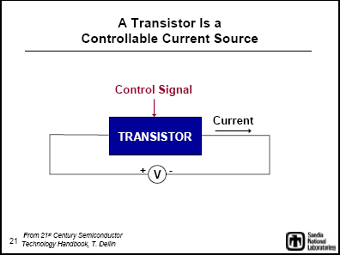

Slide 14
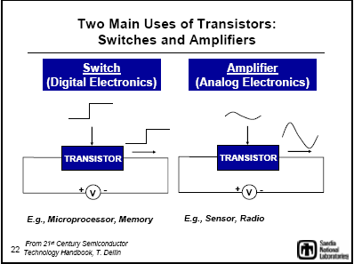

Slide 15
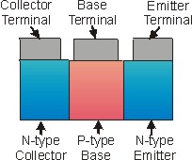
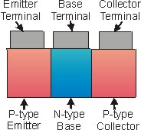
BJT Transistors:
NPN Transistor
Sandwiching a P-type layer between two n-type layers.
PNP Transistor
Sandwiching a N-type layer between two p-type layers.

Slide 16
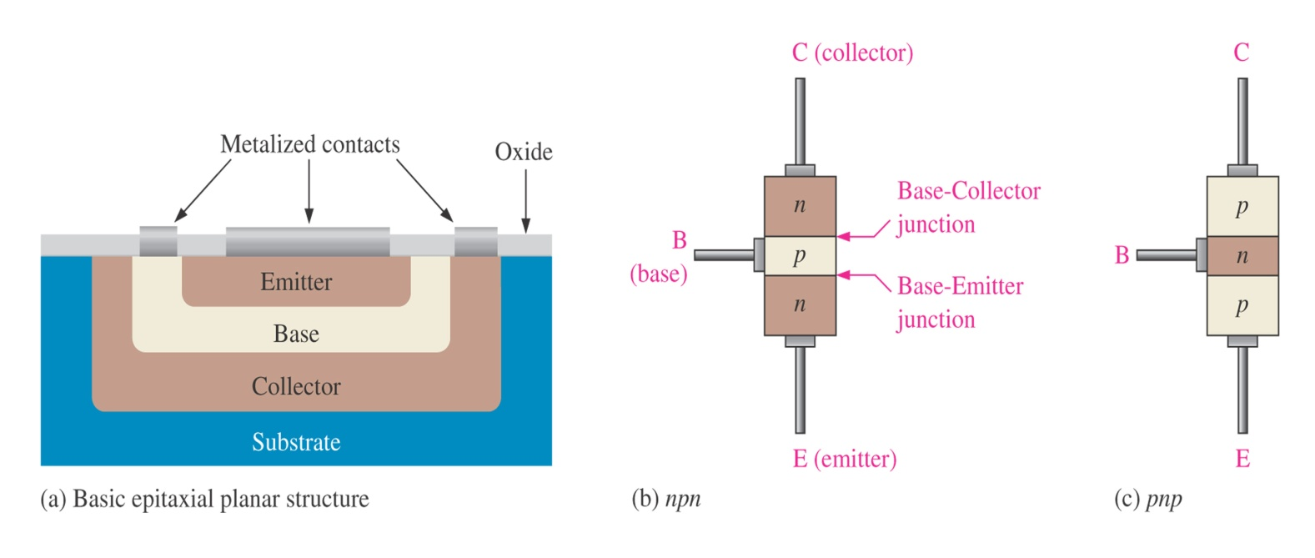
Architecture of BJTs
The bipolar junction transistor (BJT) is constructed with three doped semiconductor regions separated by two pn junctions
Regions are called emitter, base and collector

Slide 17
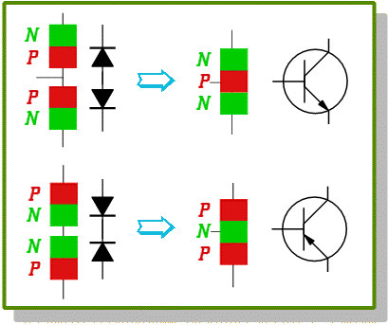
What is a Transistor?
Bipolar Junction Transistors
NPN Transistor Most Common Configuration
Base, Collector, and Emitter
  Base is a very thin region with less dopants
  Base collector junction reversed biased
  Base emitter junction forward biased

Slide 18
BJT Transistors
BJT (Bipolar Junction Transistor)
  npn
    Base is energized to allow current flow
  pnp
    Base is connected to a lower potential to allow current flow
3 parameters of interest
  Current gain (β)
  Voltage drop from base to emitter when V_{BE}=V_{FB}
  Minimum voltage drop across the collector and emitter when transistor is saturated

Slide 19
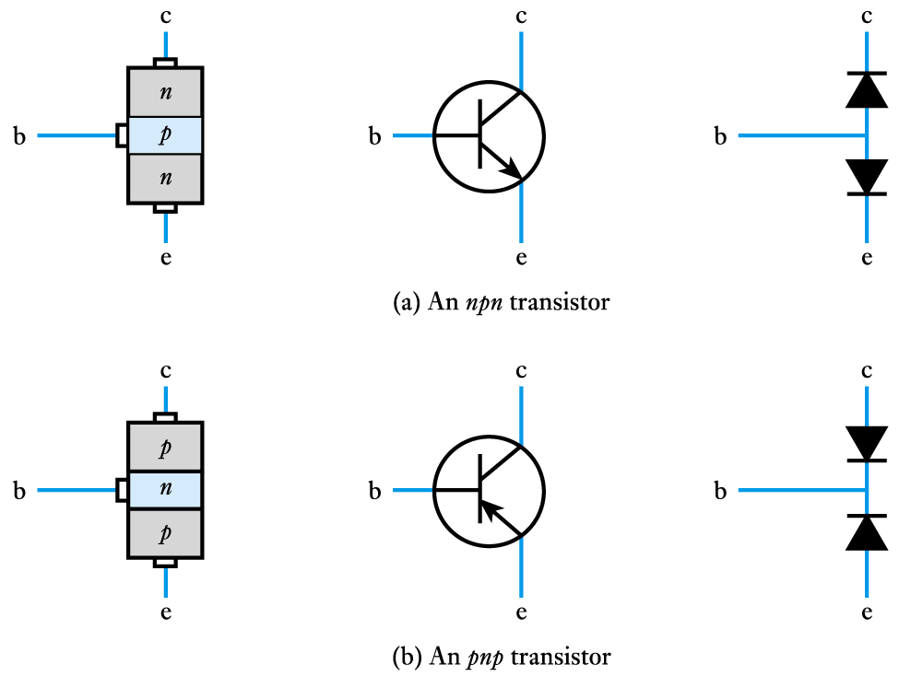
Construction
  two polarities:
  npn and pnp

Slide 20
Architecture of BJTs
There are two types of BJTs, the npn and pnp
The two junctions are termed the base-emitter junction and the base-collector junction
The term bipolar refers to the use of both holes and electrons as charge carriers in the transistor structure
In order for the transistor to operate properly, the two junctions must have the correct dc bias voltages
  the base-emitter (BE) junction is forward biased(>=0.7V for Si, >=0.3V for Ge)
  the base-collector (BC) junction is reverse biased

Slide 21
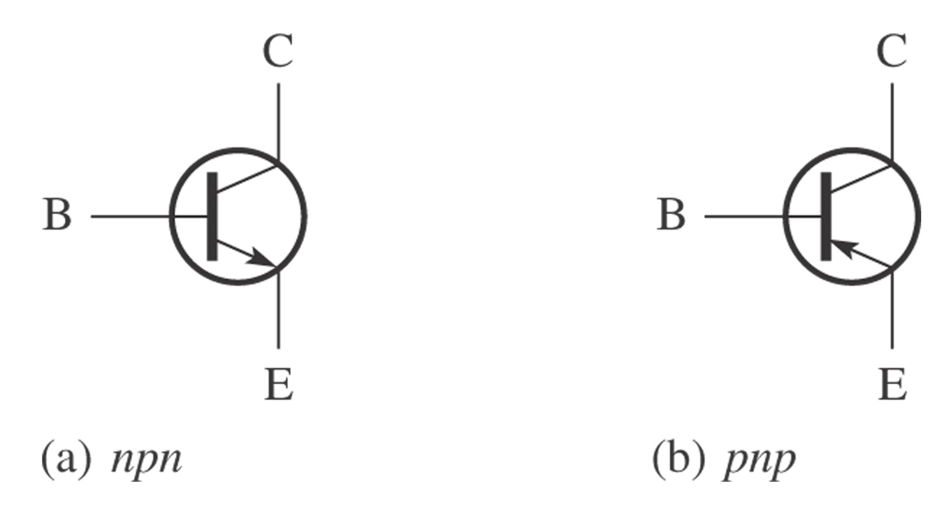
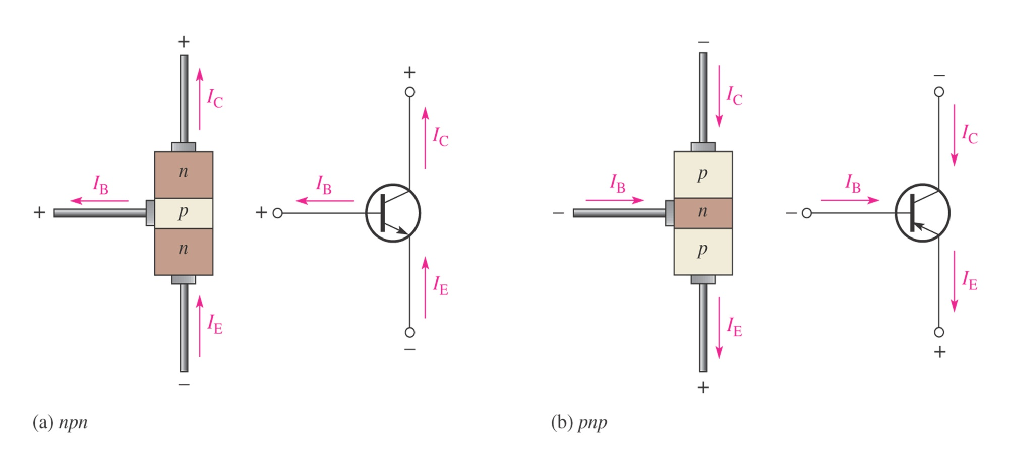
FIGURE Transistor symbols.
Thomas L. Floyd
Electronics Fundamentals, 6e
Electric Circuit Fundamentals, 6e
Copyright ©2004 by Pearson Education, Inc.
Upper Saddle River, New Jersey 07458
All rights reserved.

Slide 22
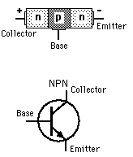
npn BJT Transistors
High potential at collector
Low potential at emitter
Allows current flow when the base is given a high potential

Slide 23
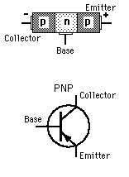
pnp BJT Transistors
High potential at emitter
Low potential at collector
Allows current flow when base is connected to a low potential

Slide 24
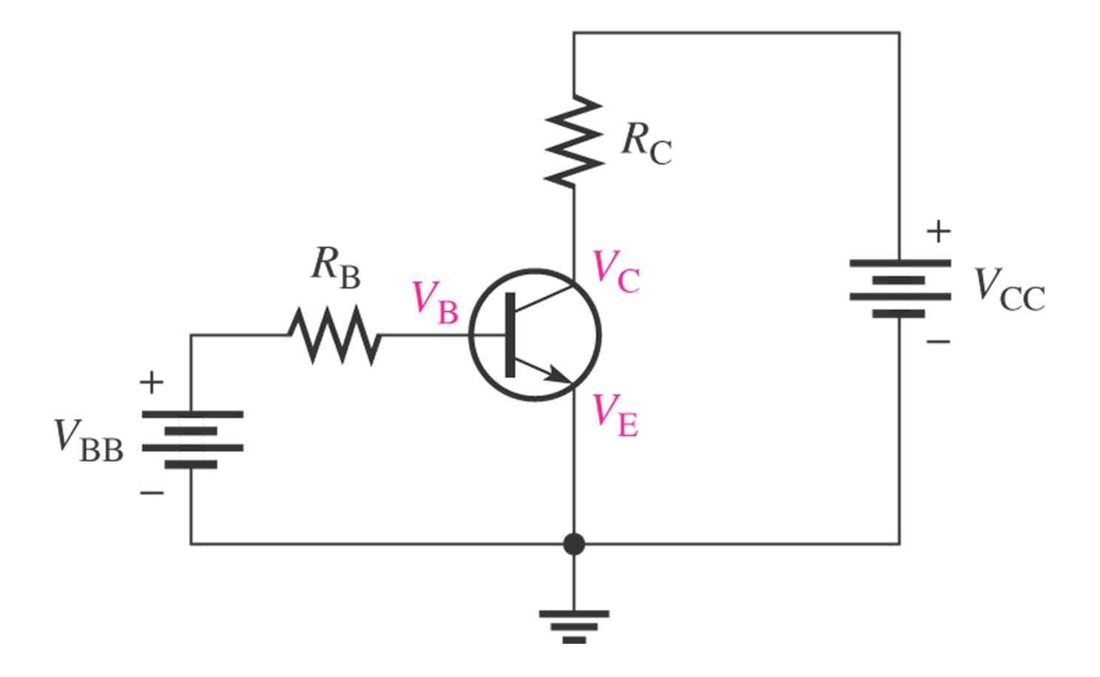
Basic circuits of BJT

Slide 25
Operation of BJTs
BJT will operates in one of following four region
  Cutoff region (for digital circuit)
  Saturation region (for digital circuit)
  Linear (active) region (to be an amplifier)
  Breakdown region (always be a disaster)

Slide 26
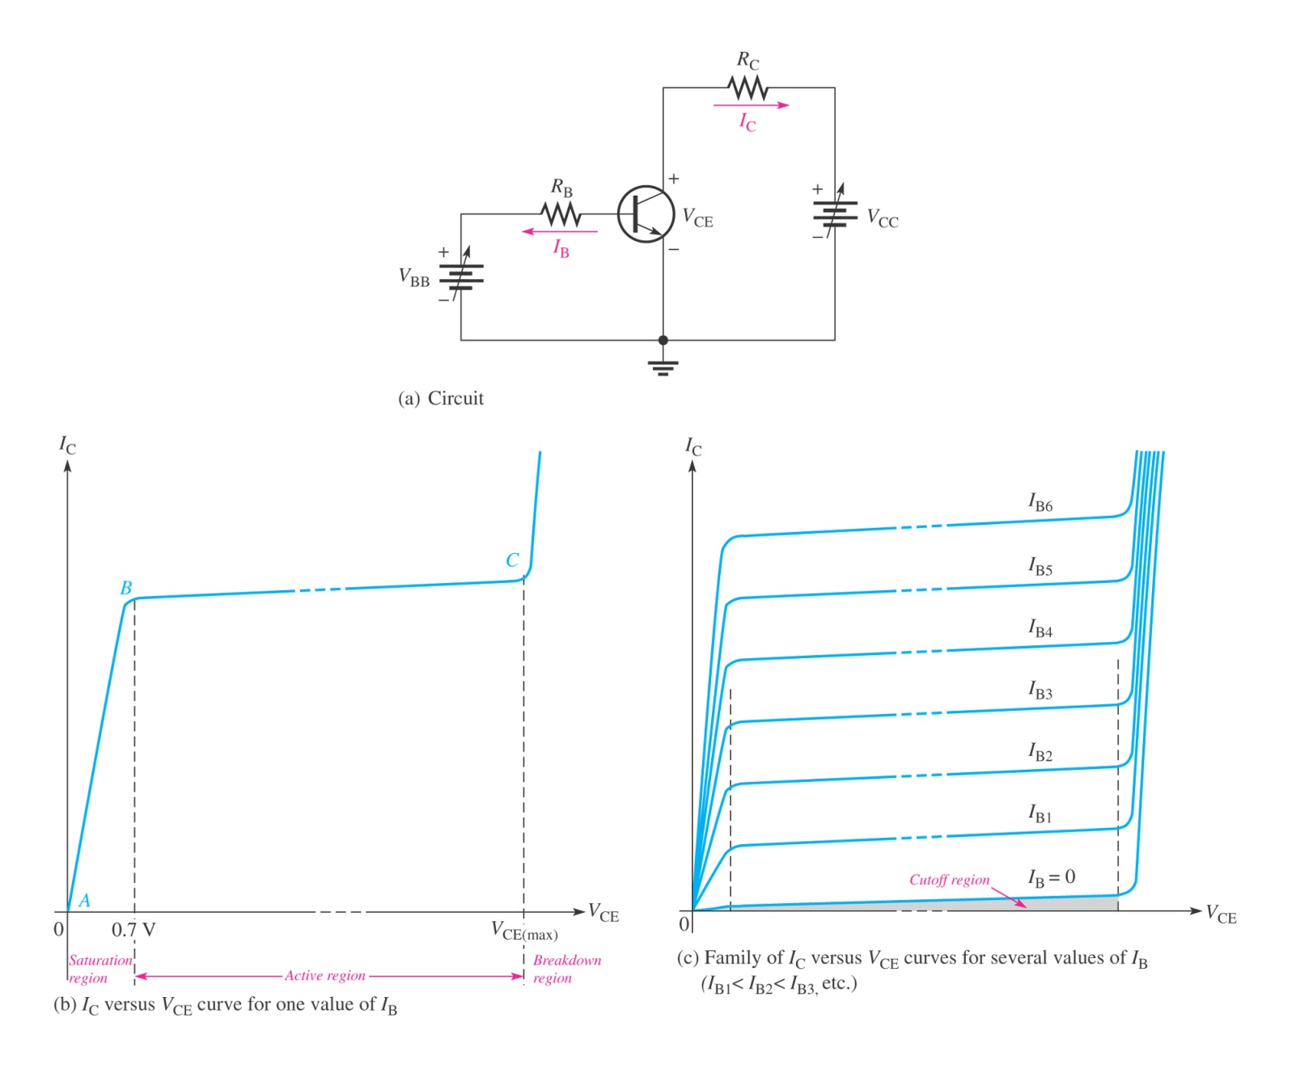
Operation of BJTs

Slide 27
FET Transistors
Analogous to BJT Transistors
FET Transistors switch by voltage rather than by current
BJT | FET
Collector | Drain
Base | Gate
Emitter | Source
N/A | Body
D
G
S

Slide 28
FET Transistors
FET (Field Effect Transistors)
  MOSFET (Metal-Oxide-Semiconductor Field-Effect Transistor)
  JFET (Junction Field-Effect Transistor)
  MESFET
  HEMT
  MODFET
Most common are the n-type MOSFET or JFET

Slide 29
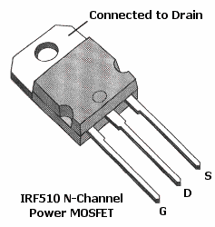
FET Transistors – Circuit Symbols
MOSFET
In practice the body and source leads are almost always connected
Most packages have these leads already connected
D
D
G
B
G
B
S
S
JFET
D
G
S

Slide 30
FET Transistors
JFET
MOSFET
gate
gate
drain
source
P
N
N
drain
N
source
P

Slide 31
JFET vs MOSFET Transistors
MOSFET | JFET
High switching speed | Will operate at V_{G}<0
Can have very low R_{DS} | Better suited for low signal amplification
More commonly used as a power transistor
Current flow
D
G
B
S

Slide 32
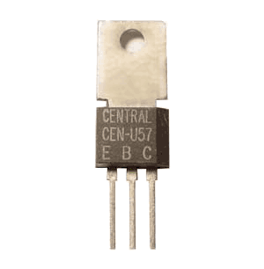
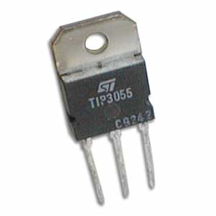
Power Transistors
Additional material for current handling and heat dissipation
Can handle high current and voltage
Functionally the same as normal transistors

Slide 33
Transistor Uses
Switching
Amplification
Variable Resistor

Slide 34
Transistor as a Switch
Transistors can be used as switches.¹
Transistor
Switch
Transistors can either
conduct or not conduct current.²
ie, transistors can either be on or off.²

Slide 35
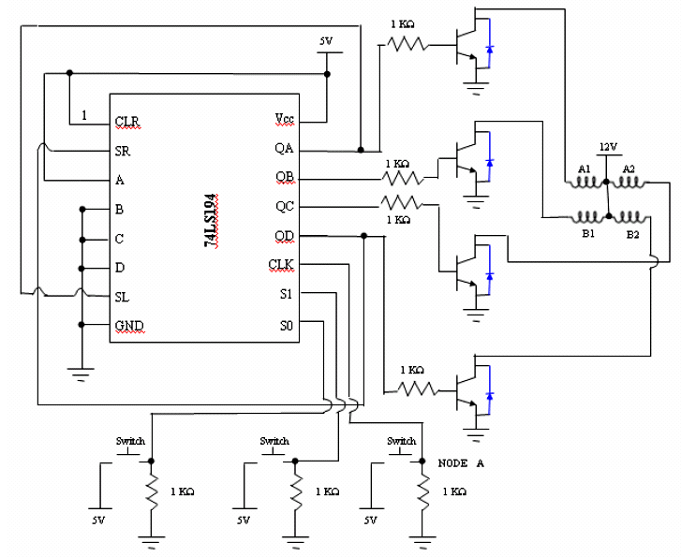

Practical Examples - Switching

Slide 36
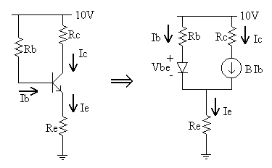
Transistor as an amplifier:
Transistors are often used as amplifiers to increase input signal in radios, televisions and some other applications .The circuit may be designed to increase the current or voltage level.
The power gain is the product of current gain and voltage gain (P=V*I).

Slide 37
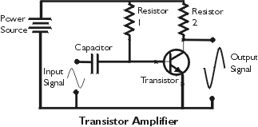
Amplifier example:
As you see, the transistor is biased to be always on. The input signal is amplified by this circuit. The frequency of output is the same as its input, but the polarity of the signal is inverted.
The measure of amplification is the gain of transistor.
Example:
Input Amplitude =0.2v
Output amplitude=10v
Gain=10/0.2=50

Slide 38
Practical Examples - PWM
Power to motor is proportional to duty cycle
MOSFET transistor is ideal for this use
DC motor

Slide 39
Practical Examples – Darlington Pair
Transistors can be used in series to produce a very high current gain

Slide 40
Advantages
The key advantages that have allowed transistors to replace their vacuum tube predecessors in most applications are
Small size and minimal weight, allowing the development of miniaturized electronic devices.
Low operating voltages compatible with batteries of only a few cells.
No warm-up period for cathode heaters required after power application.
Lower power dissipation and generally greater energy efficiency.
Higher reliability and greater physical ruggedness.
Extremely long life. Some transistorized devices have been in service for more than 50 years.

Slide 41
Questions?

Slide 42
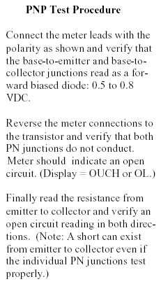
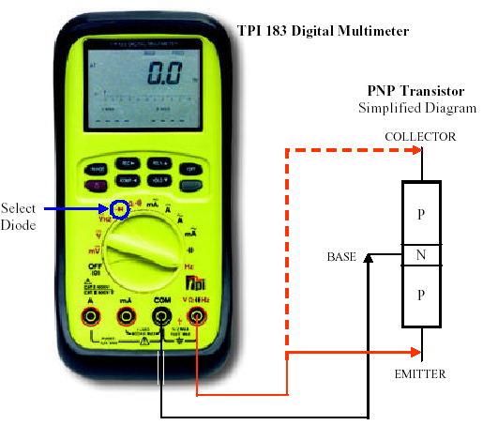
BJTs – Testing

Slide 43
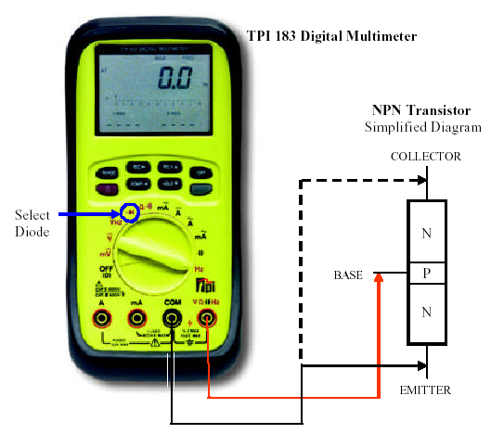
BJTs – Testing

Slide 44
Image references
http://www.owlnet.rice.edu/~elec201/Book/images/img95.gif
http://nobelprize.org/educational_games/physics/transistor/function/p-type.html
http://www.electronics-for-beginners.com/pictures/closed_diode.PNG
http://people.deas.harvard.edu/~jones/es154/lectures/lecture_3/dtob.gif
http://en.wikipedia.org/wiki/Image:IvsV_mosfet.png
http://www.physlink.com/Education/AskExperts/ae430.cfm
http://www.kpsec.freeuk.com/trancirc.htm

